Slide 1
Introduction to IoT The Internet of Things

Slide 2
What is IoT? Your definition

Slide 3
Internet: Human-to-Human IoT: Everything to Everything Communication

Slide 4
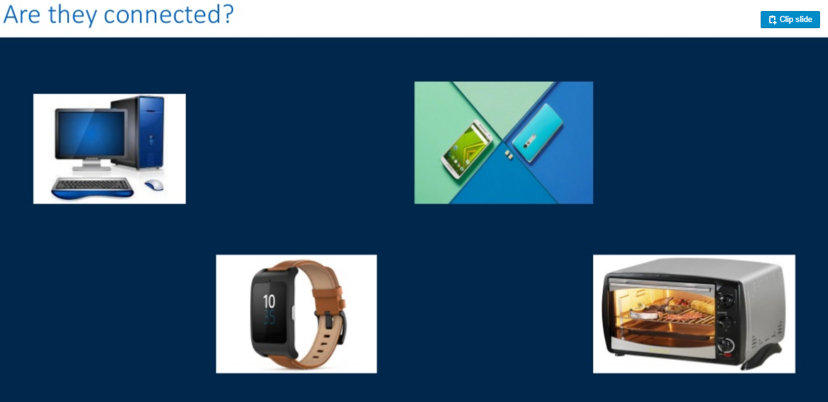

Slide 5
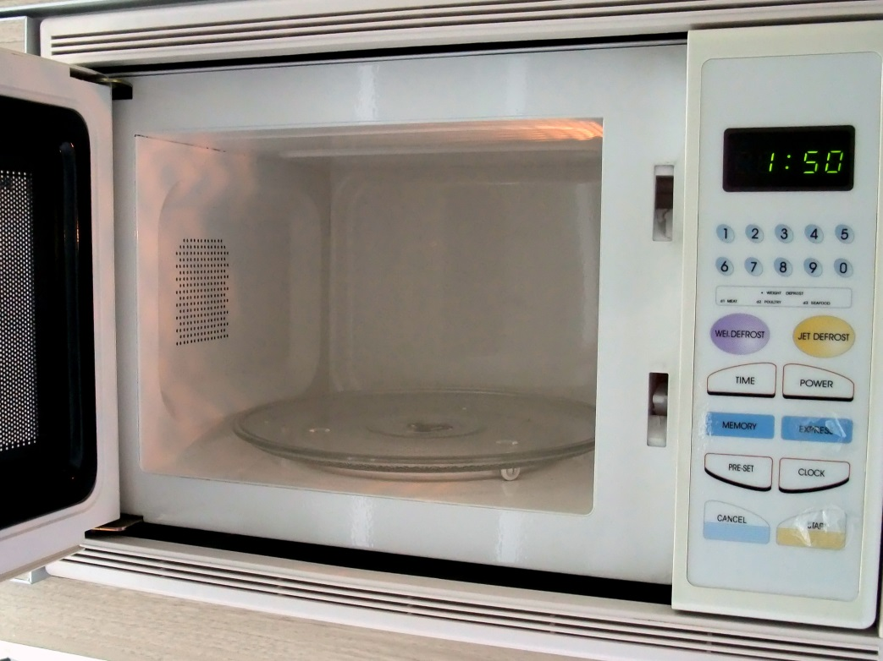
Is this a Connected Device?

Slide 6
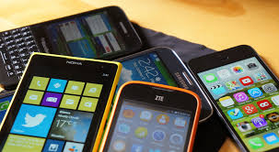
Is this a Connected Device?

Slide 7

Is this a Connected Device?

Slide 8
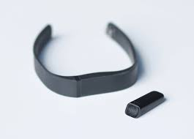
Is this a Connected Device?

Slide 9




How about?

Slide 10
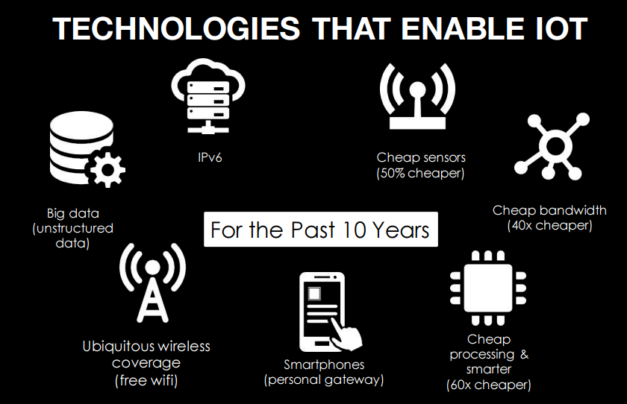

Slide 11
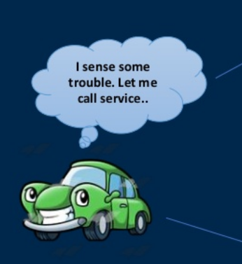


Slide 12
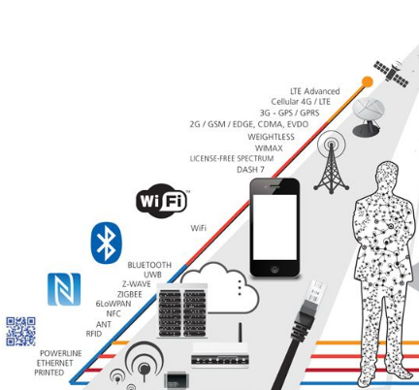
Modes of Connectivity

Slide 13
In 2016, 6.4 billion devices connected to the internet –
and 5.5 million new 'things' joined them each day.
- Gartner Prediction

Slide 14
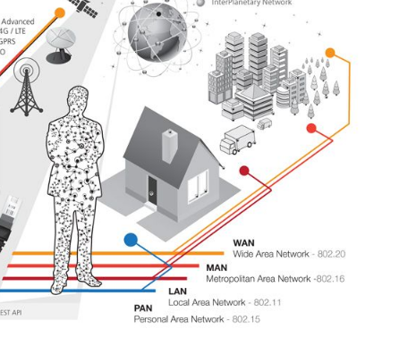

Slide 15
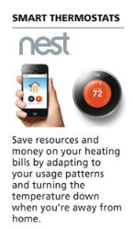
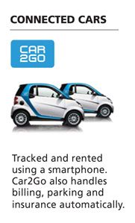
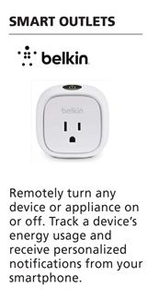

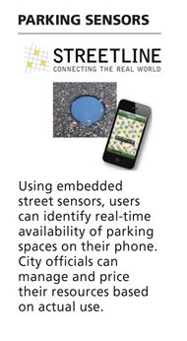
How it started

Slide 16
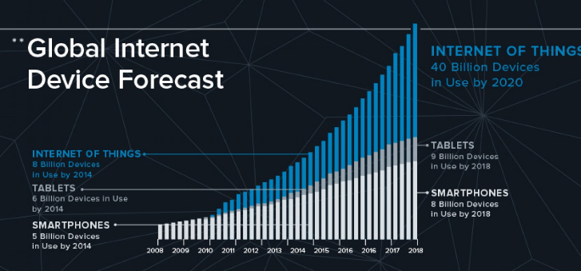
http://visual.ly/future-internet-things

Slide 17
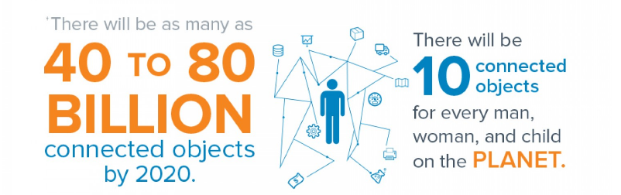
http://visual.ly/future-internet-things

Slide 18
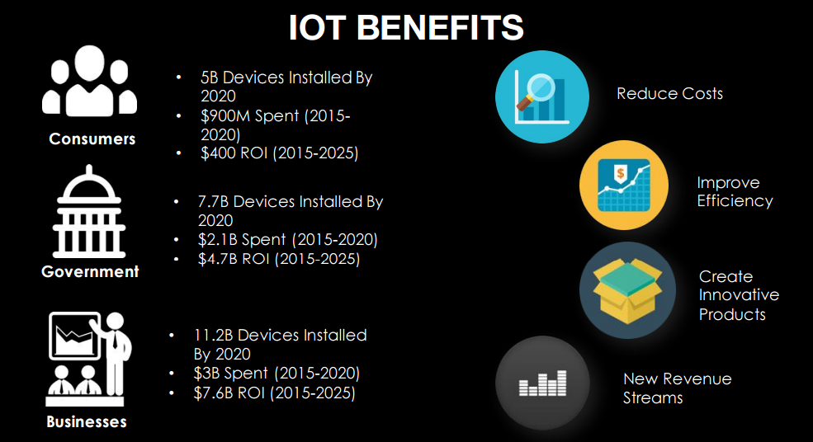

Slide 19
Where can it be applied?

Slide 20
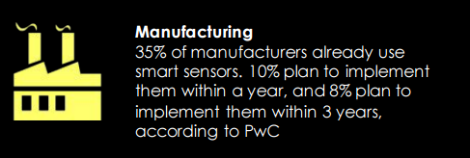
http://www.cbronline.com/news/internet-of-things/m2m/smart-connected-always-on-10-huge-iot-impacts-on-10-huge-sectors-4709736v]

Slide 21
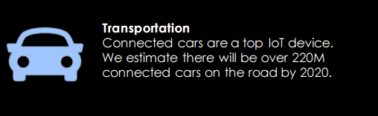
http://www.cbronline.com/news/internet-of-things/m2m/smart-connected-always-on-10-huge-iot-impacts-on-10-huge-sectors-4709736v]

Slide 22
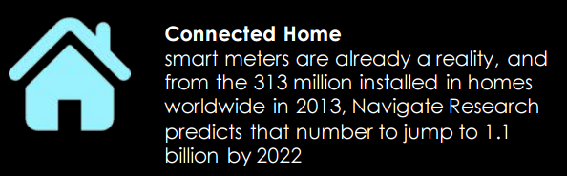

Slide 23
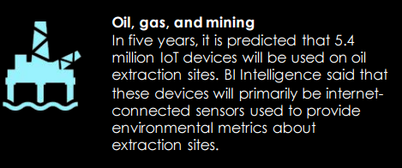
http://www.cbronline.com/news/internet-of-things/m2m/smart-connected-always-on-10-huge-iot-impacts-on-10-huge-sectors-4709736v]

Slide 24
